Slide 1
ORCiD Account
Dr Hazel A Smith
(IACRN Research Committee)

Slide 2
What is ‘ORCiD’
Benefits of ORCiD Account (IACRN)
Setting up an ORCiD Account (Brief)

Slide 3
You control your ORCiD Account

Slide 4
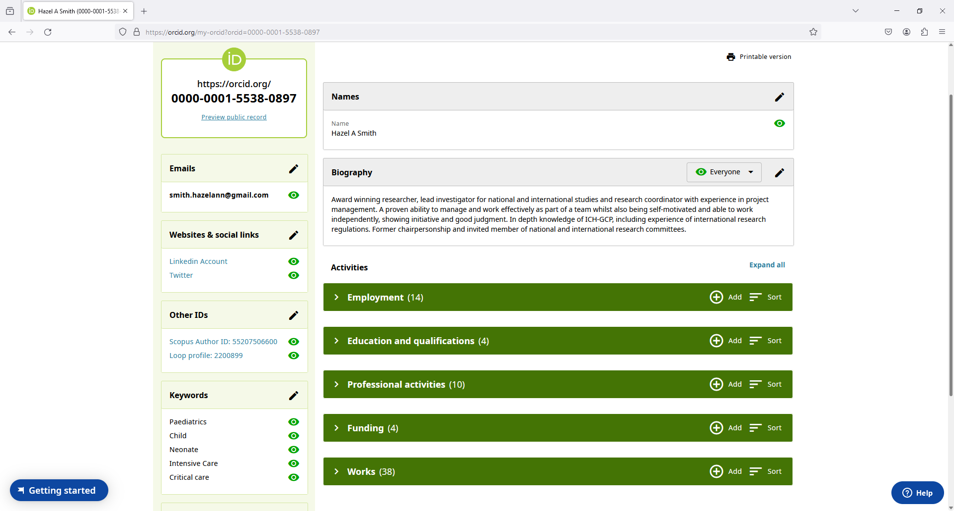

Slide 5
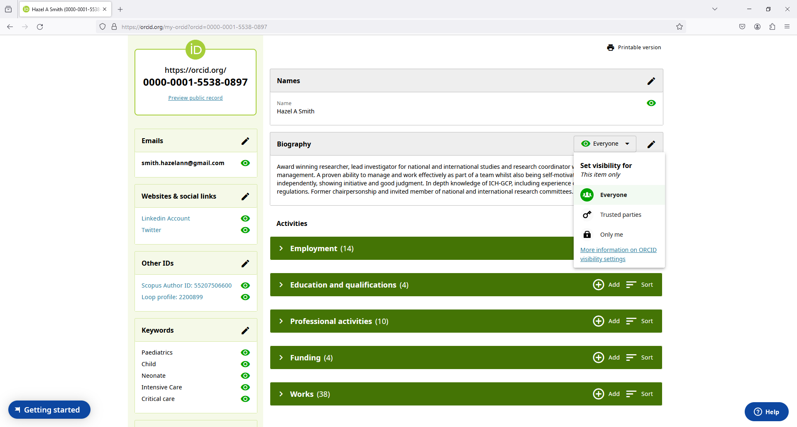

Slide 6
What is ‘ORCiD’
Benefits of ORCiD Account (IACRN)
Setting up an ORCiD Account (Brief)

Slide 7
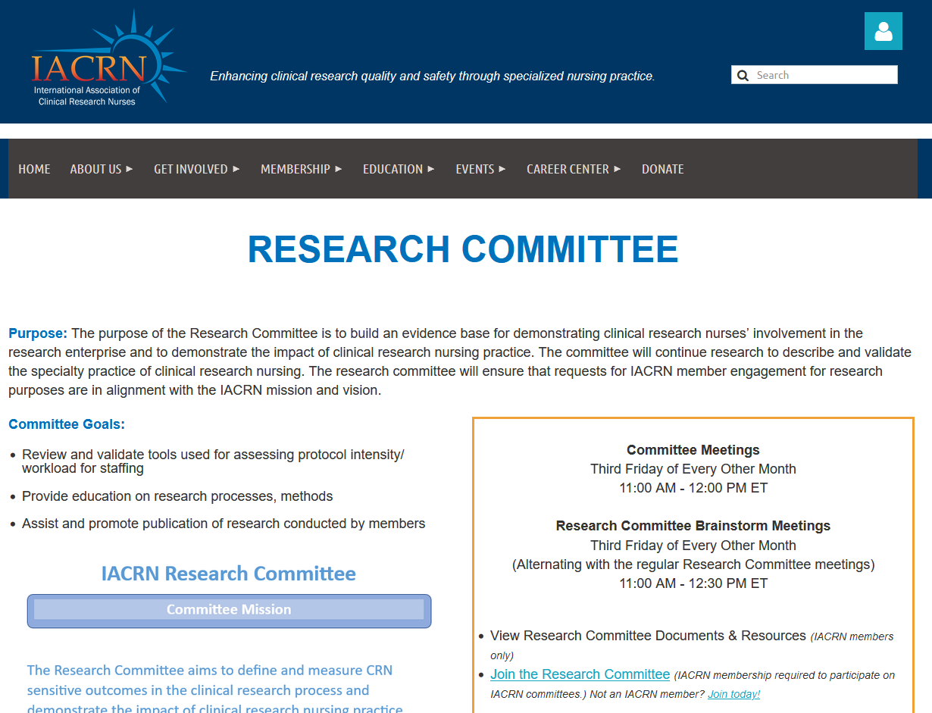
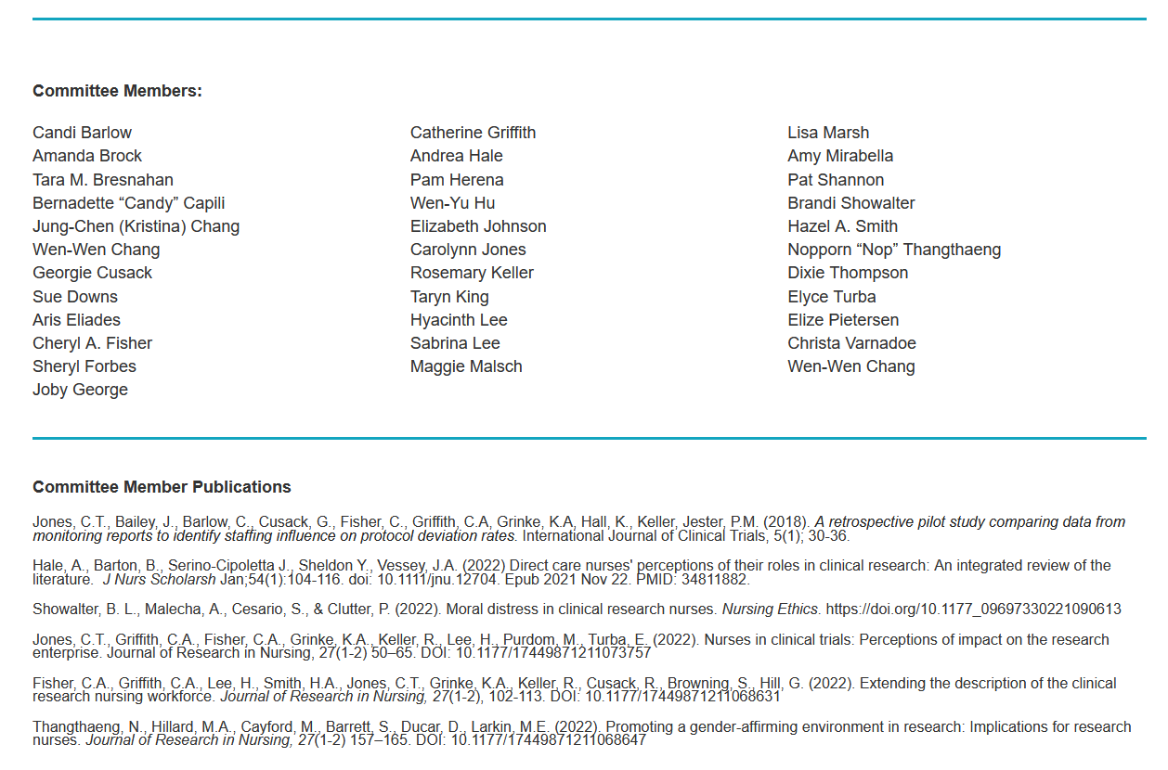
Is the page up-to-date?
Reminder emails
Respond to emails
Update page as needed
Any typos/ mistakes?

Slide 8
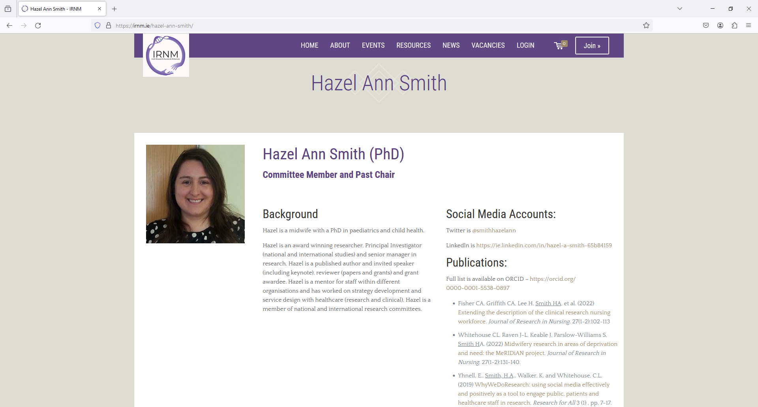

Slide 9
What is ‘ORCiD’
Benefits of ORCiD Account (IACRN)
Setting up an ORCiD Account (Brief)

Slide 10
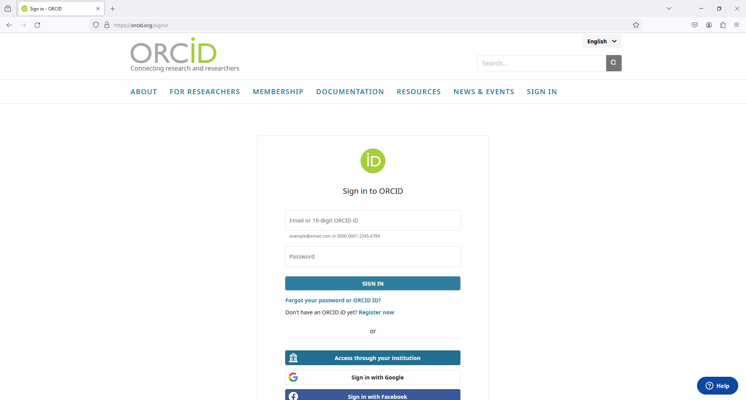

Slide 11
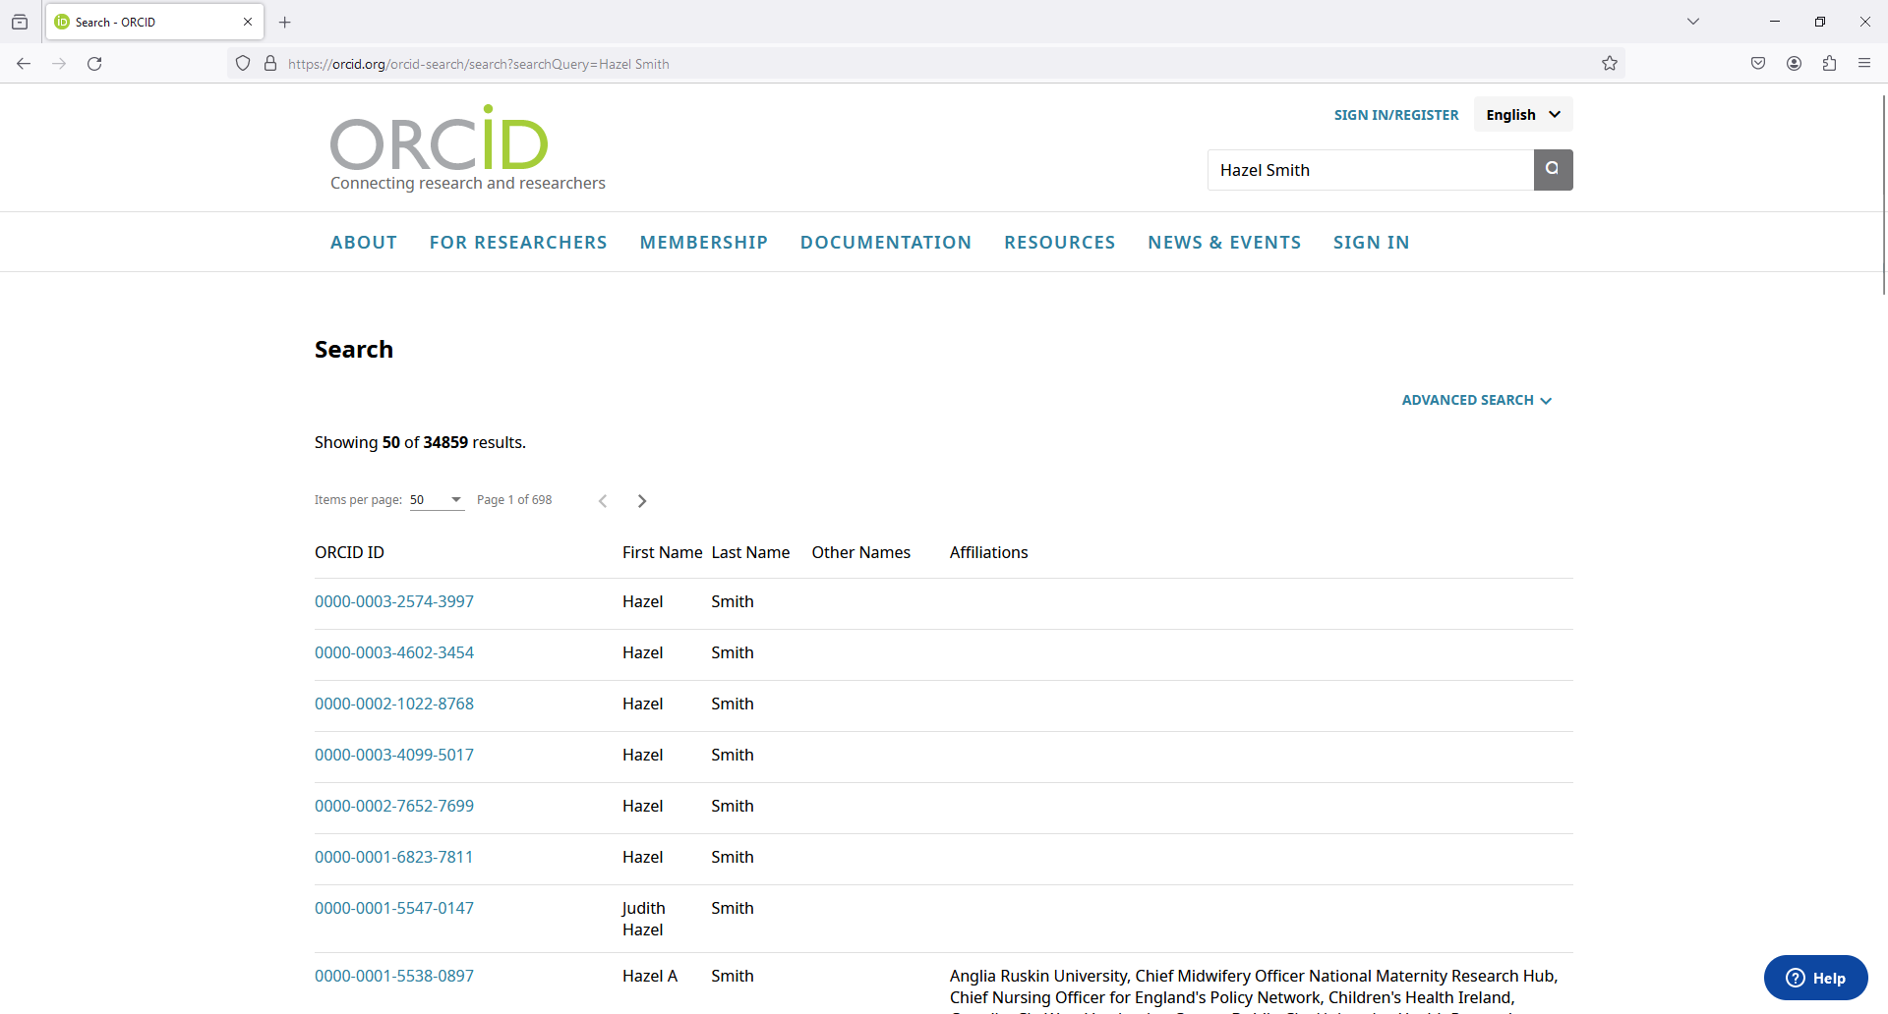

Slide 12
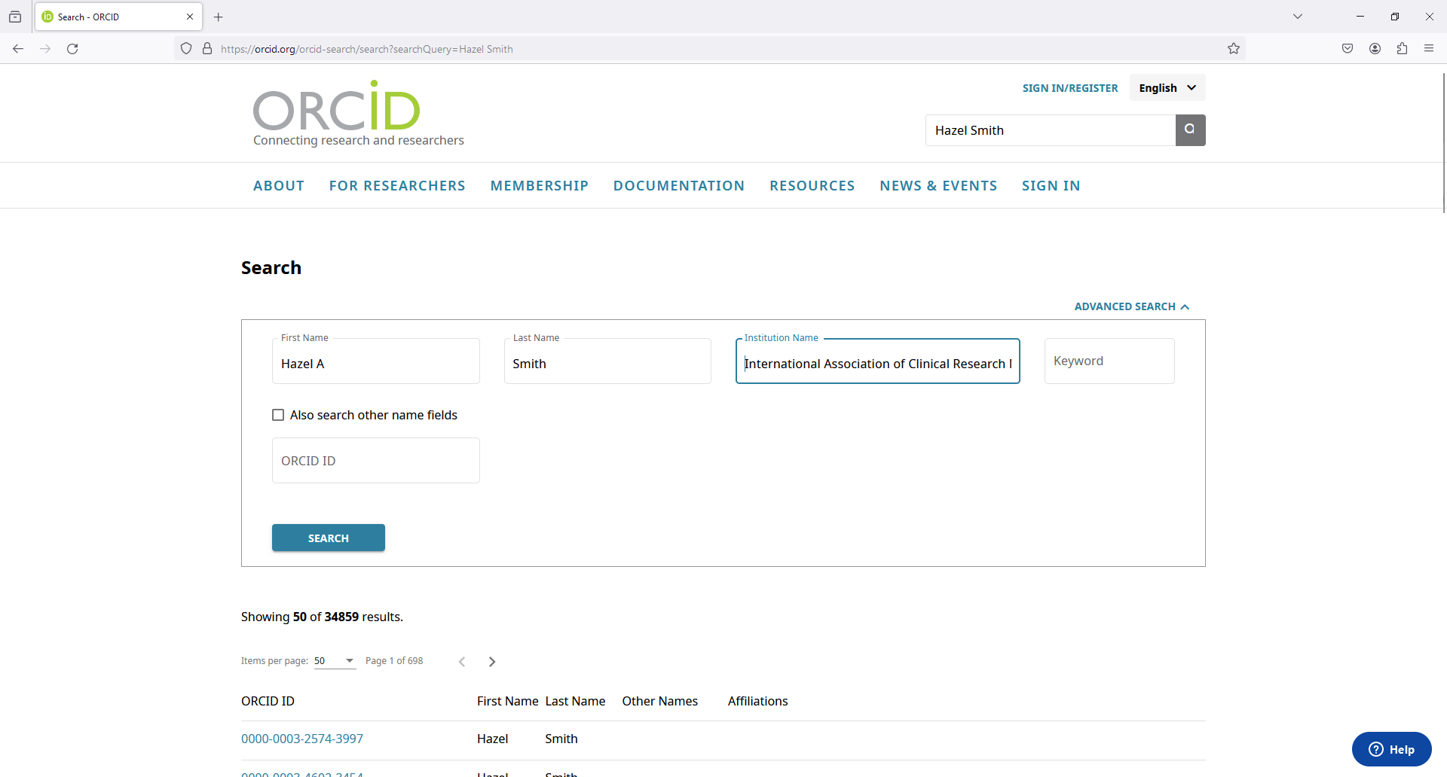

Slide 13
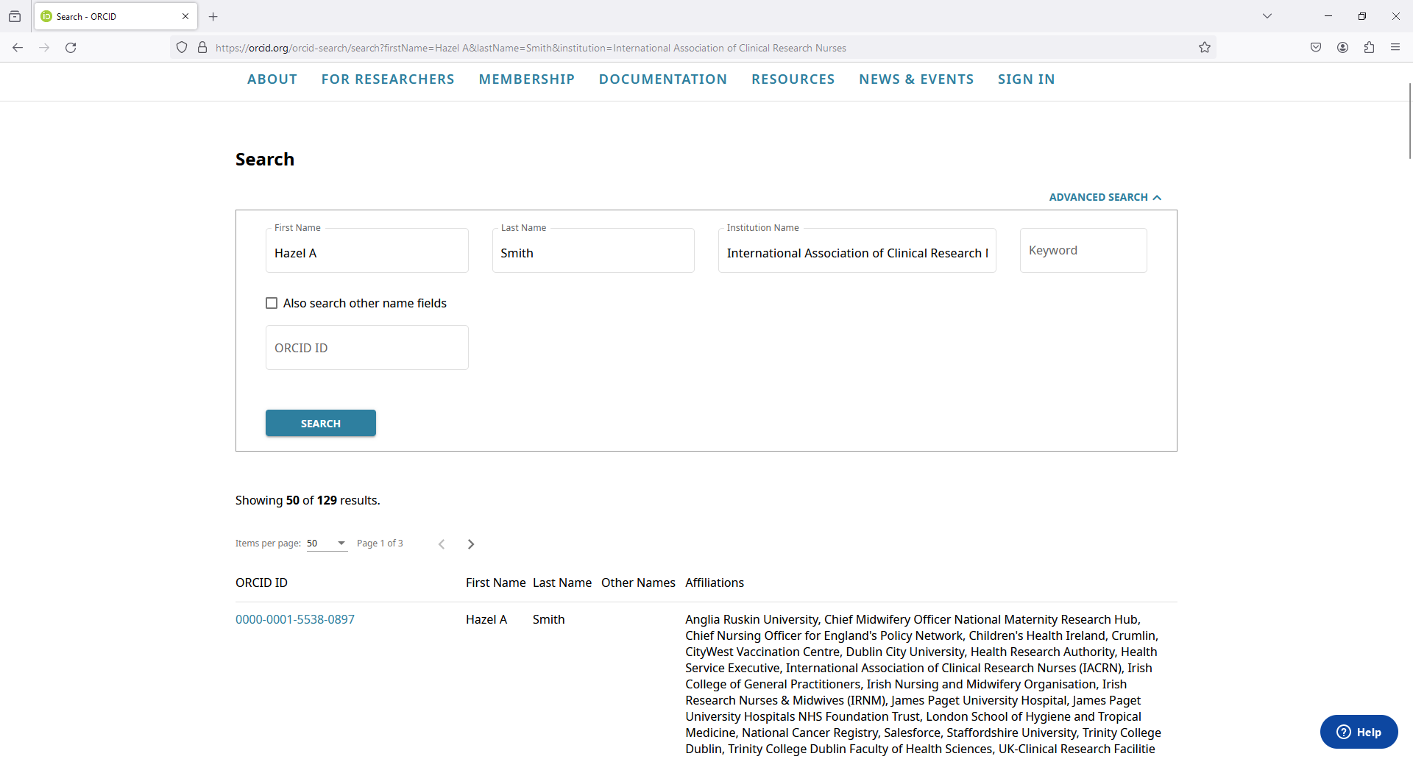

Slide 14
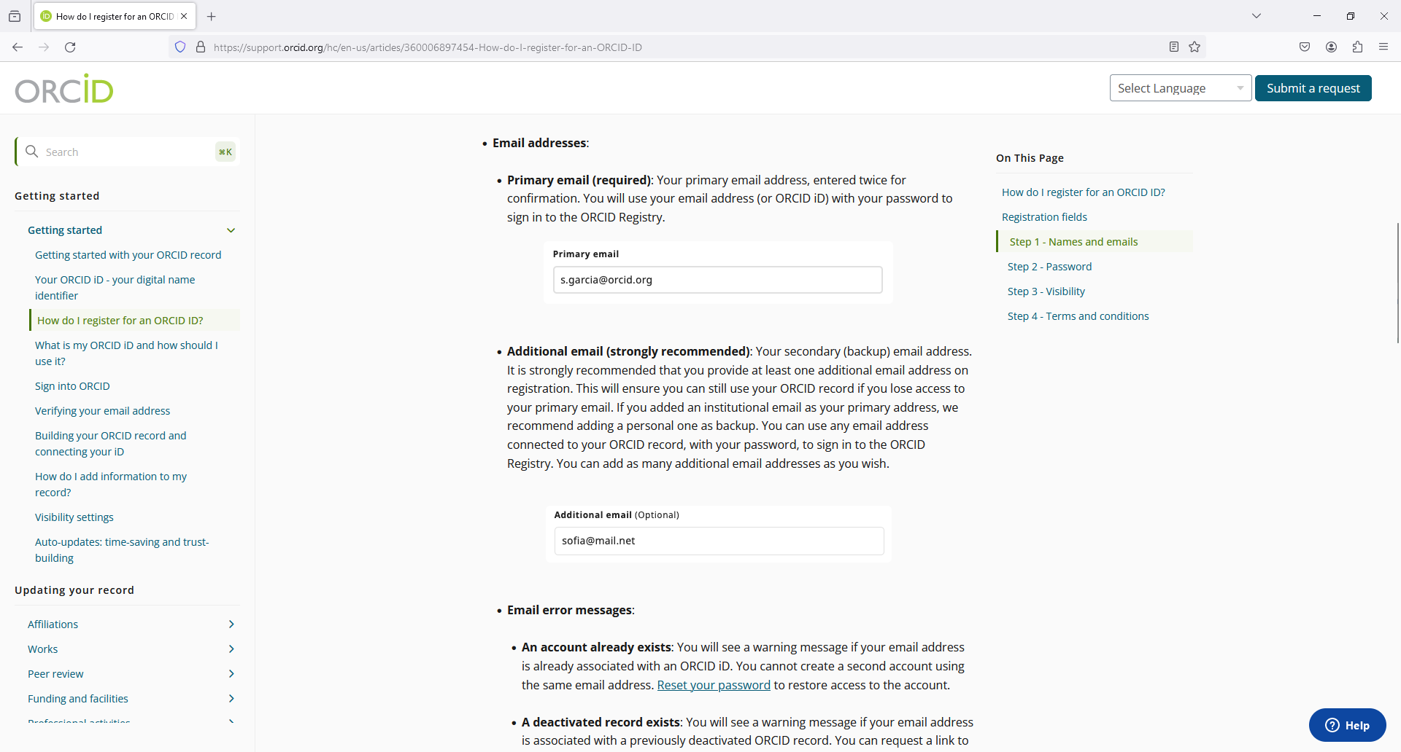

Slide 15
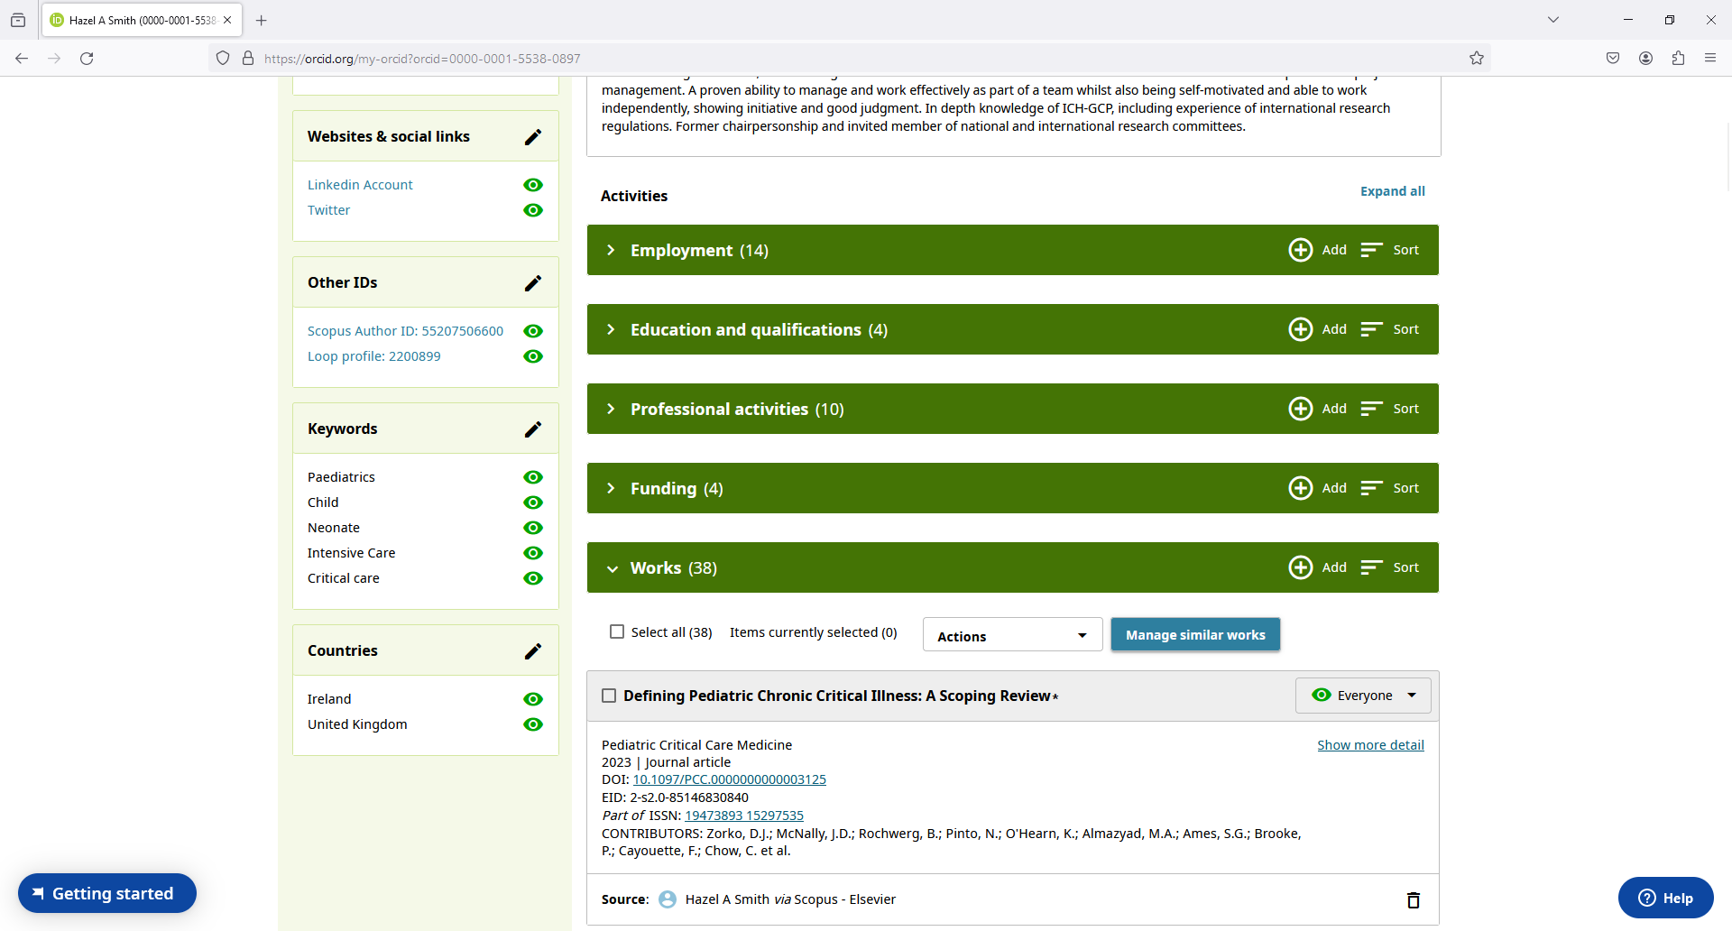

Slide 16
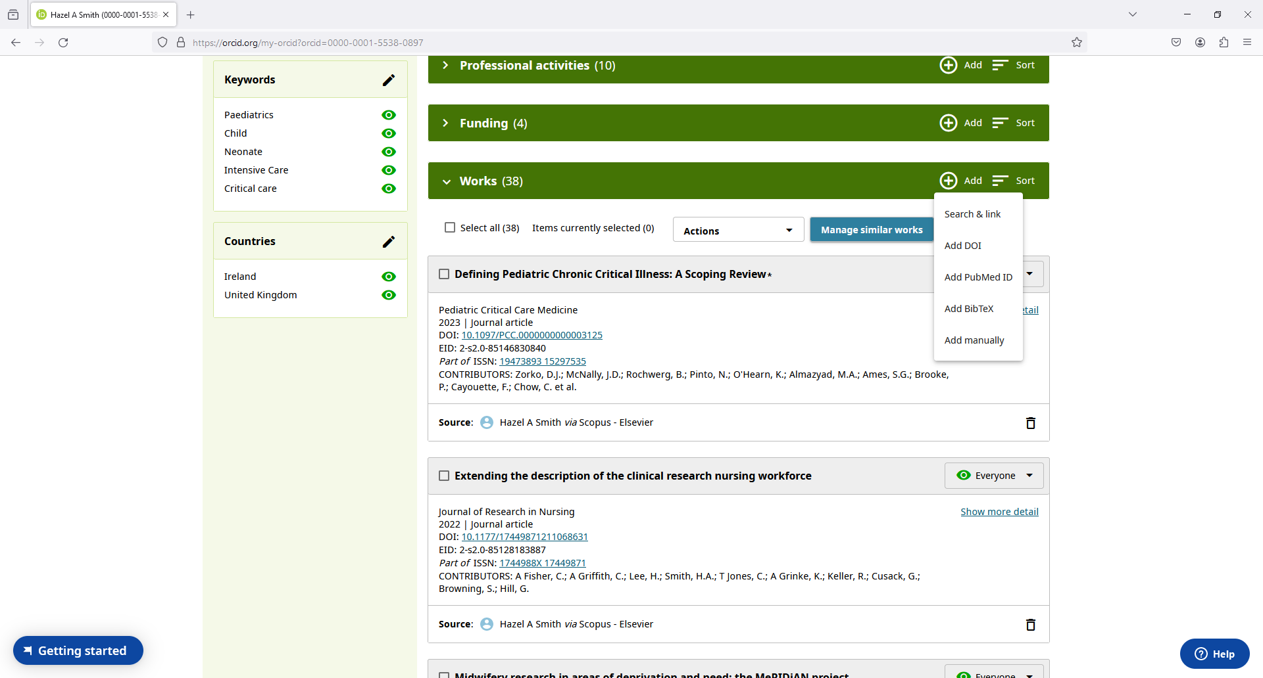

Slide 18
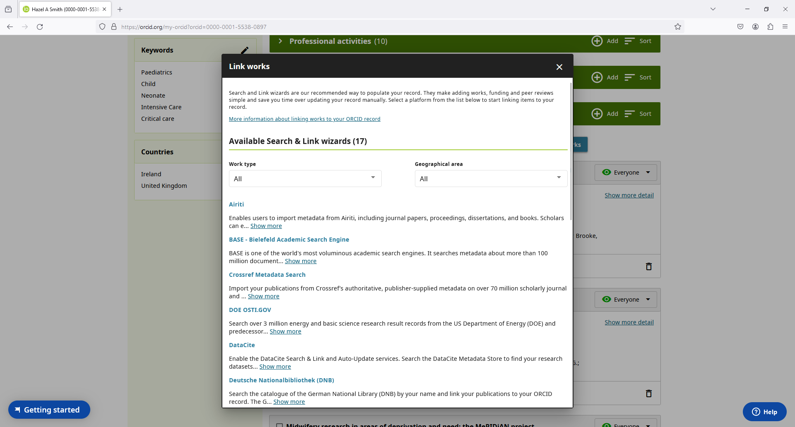

Slide 19
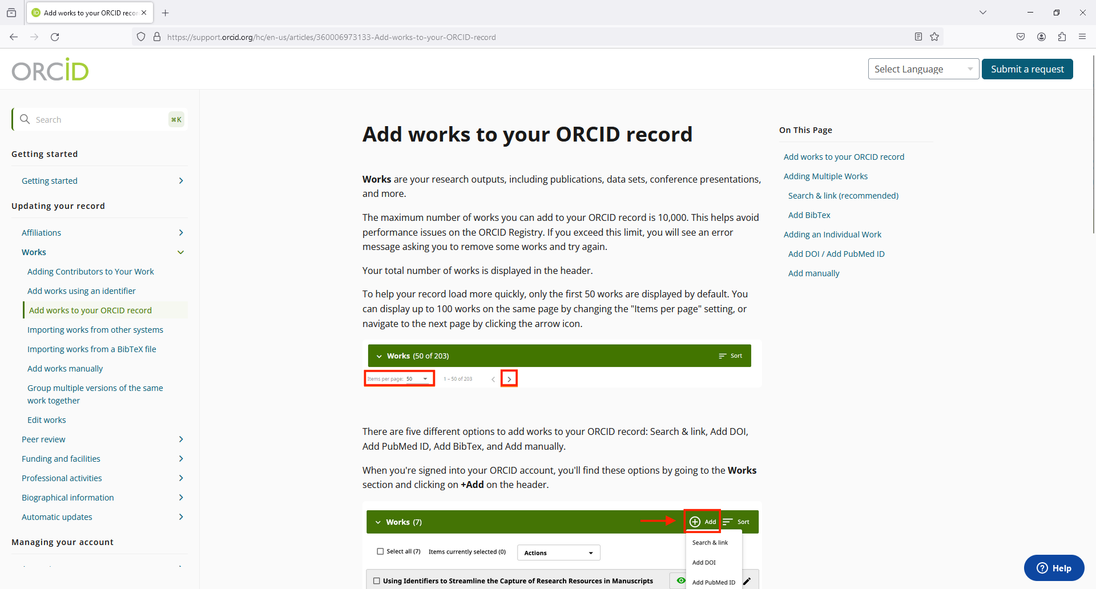

Slide 20
ORCiD Account
Dr Hazel A Smith
(IACRN Research Committee)

